Slide 1

Time review

Slide 2
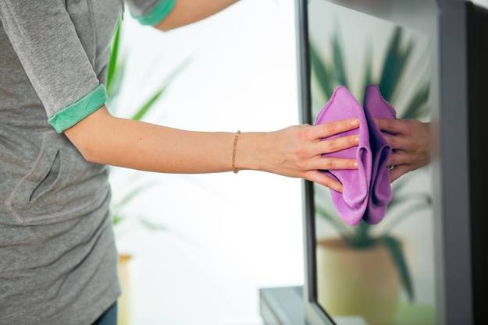
Phonetic workout
Dust is a Dick's worst enemy

Slide 3
Present perfect
have
I
He/ She/It
They/ You/ We
have
has
have
enjoyed
written (3 ф.гл. – irr.v.)
taken (3 ф.гл. – irr.v.)
Have I enjoyed?
Has he written?
Have we taken?
I have not enjoyed
He has not written
We have not taken

Slide 4
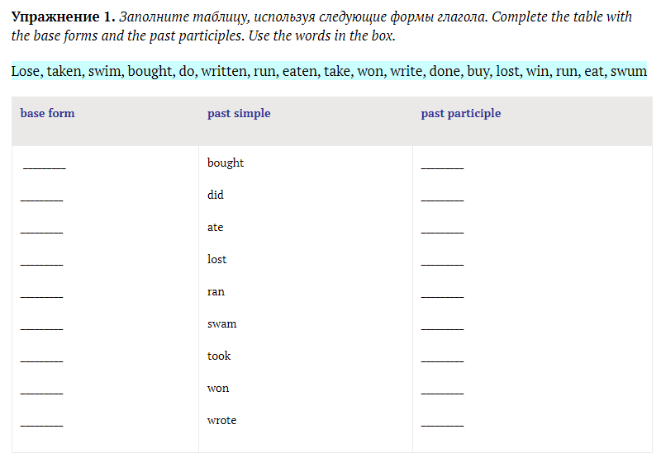
Fill the form with correct words

Slide 5
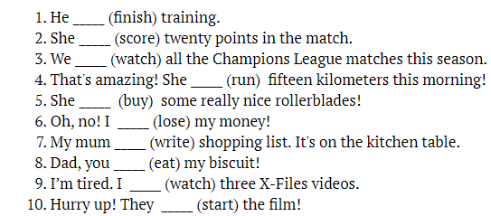
Put the verbs in Present Perfect

Slide 6
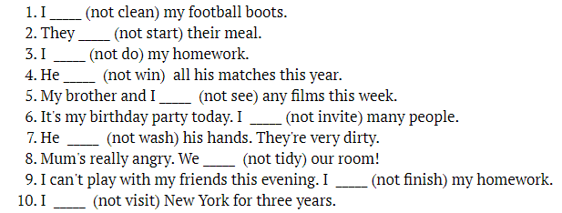
Make negative sentences in Present Perfect

Slide 7
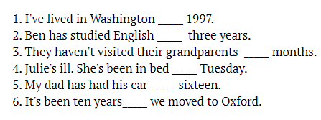
FOR or SINCE?

Slide 8
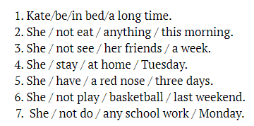
Put the words in the correct order

Slide 9
Present perfect continuous
I
He/ She/It
They/ You/ We
have been
has been
have been
reading
reading
reading
Have I been reading?
Has he been reading?
Have we been reading?
I have not been reading
He has not been reading
We have not been reading
have been

Slide 10
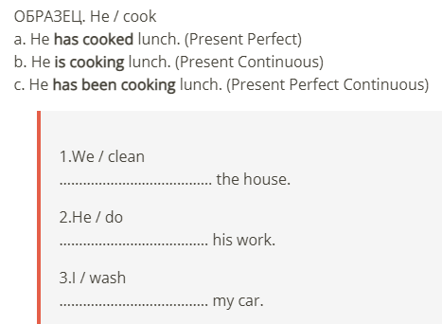
Make the sentences as in an example

Slide 11
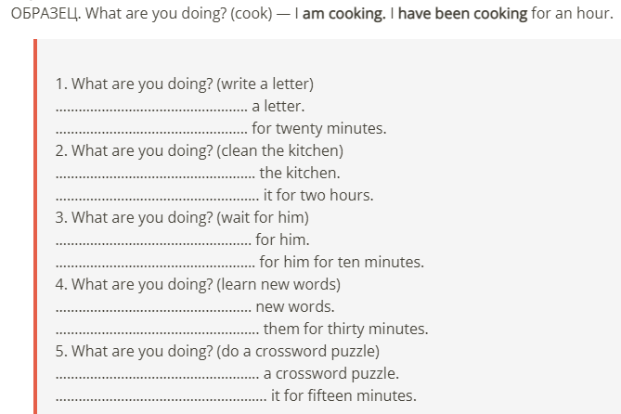
Make the sentences as in an example

Slide 12
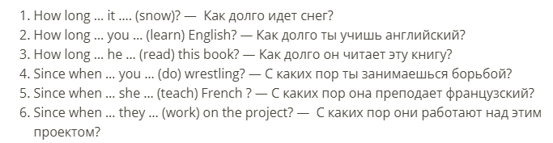
Put the verbs in the correct form

Slide 13


